Slide 1

Relational Model
Database Systems
Department of Computer Science, CBNU
Prof. Nasridinov Aziz (aziz@chungbuk.ac.kr)

Slide 2
Table of Contents
Relational Model
Characteristics of Relation
Keys
Integrity Constraints
Pros and Cons of Relational Model
Summary and Discussions

Slide 3
Last Lecture
Data
  Information that is stored or transmitted electronically
  Structured Data vs. Unstructured Data
Database
  An organized collection of data
Database Management Systems (DBMS)
  A software designed to store, retrieve, define, and manage data in a database
Database Systems
  Users, application programs, DBMS and stored database are referred to as a database system

Slide 4
Last Lecture
Data Model
  A syntax or grammar used to show how data is stored, connected, accessed and updated in the DBMS
Types of data models
  Hierarchical Model
  Network Model
  Hybrid Model
  Relational Model <- This lecture will focus on Relation Model
  Object-Oriented Model
  Object-Relational Model
The relational model is one of the simplest and easy to understand data models

Slide 5
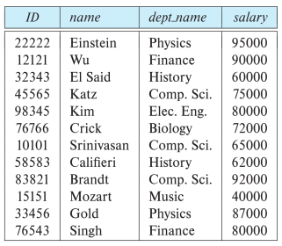
Last Lecture
Relational model represents the database as a collection of relations
  Relation = table
The instructor table

Slide 6
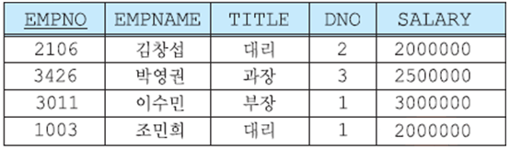
1. Relational Model
What do you know about the table?
  Given the following table, find:
    Name of the table
    Rows of the table
    Columns of the table
    The number of rows
    The number of columns

Slide 7
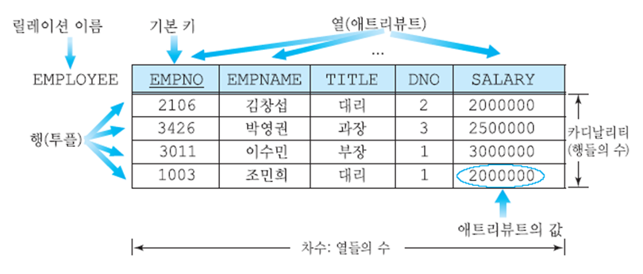
1. Relational Model
Basic terminologies

Slide 8
1. Relational Model
Basic terminologies
  Relation
    A two-dimensional table
  Tuple
    A row of the relation
  Attribute
    A column of the relation
  Primary key
    An attribute or a set of attributes which helps you to UNIQUELY identify a tuple in a relation

Slide 9
1. Relational Model
Basic terminologies
  Degree
    The number of attributes in the relation
      The minimum degree of a valid relation must be 1
      The degree of the relation does not change often
  Cardinality
    The number of tuples/records in the relation
      The cardinality of a valid relation can be 0
      The cardinality of the relation keeps changing over time

Slide 10
1. Relational Model
Basic terminologies
  Domain
    Data type describing the type of values in each column
      Example 1: EMPNO int
      Example 2: EMPNAME varchar(20)
  Relation Schema
    Structure of the relation denoted by R(A1, A2, … , An)
    Ex: EMPLOYEE(EMPNO, EMPNAME, TITLE, DNO, SALARY)
  Relation Instance
    A set of n tuples

Slide 11
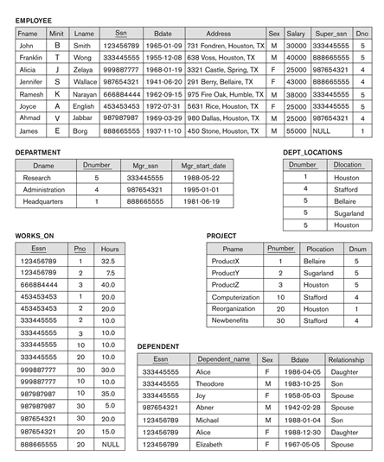
1. Relational Model
Basic Terminology
  Example of Relation Instance

Slide 12
1. Relational Model
Basic Terminology
  Relational Database Schema
    A set S of relation schemas that belong to the same database
    S is the name of the whole database schema
    S = {R1, R2, ..., Rn}
    R1, R2, …, Rn are the names of the individual relation schemas within the database S
  Following slide shows a COMPANY database schema with 6 relation schemas

Slide 13
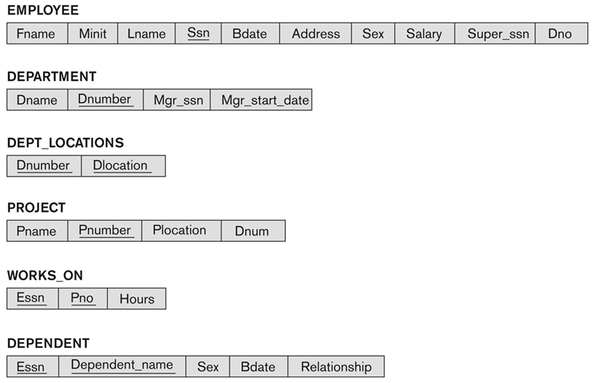
1. Relational Model
Basic Terminology
  Relational Database Schema
    Example: a COMPANY database schema

Slide 14
1. Relational Model
Basic terminologies
  NULL value
    Used to indicate ‘unknown’ or ‘not applicable’
    Example
      You enter a tuple about a new employee in an employee relation. However, the new employee's DNO (department number) may not be determined yet. In this case, DNO is unknown or has NULL value.
    NULL value is different from a zero in the numeric domain or blank character in the string domain
    Different DBMSs use different symbols to represent null values

Slide 15
Quiz
Fill out the form with correct terminology from relational model
Frequently Used (Informal Terminology) | Relational Model (Formal Terminology)
Table
Row
Column
Unknown Value
Table Definition
Table with Data
All Possible Values in a Column

Slide 16
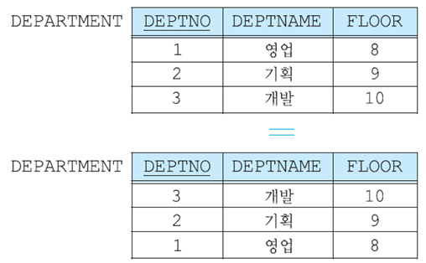
2. Characteristics of Relation
Characteristics of relation
  Each relation in a database must have a distinct or unique name
  The order of tuples in the relation is NOT important

Slide 17
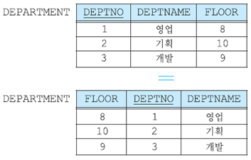
2. Characteristics of Relation
Characteristics of relation
  Each attribute in a relation must have a distinct or unique name
  The order of attributes in the relation is NOT important

Slide 18
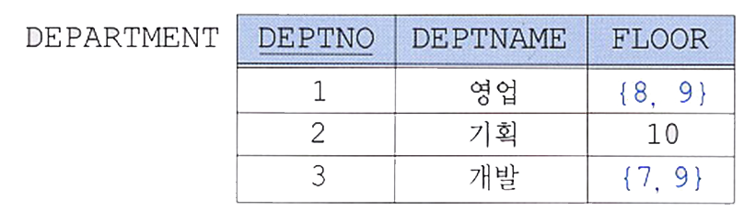
2. Characteristics of Relation
Characteristics of relation
  A relation does not allow duplicate tuples
  Each cell contains an indivisible (atomic) value, not a list or set
Not allowed because these tuples have multiple values

Slide 19
3. Keys
Key
  An attribute or a set of attributes which helps you to identify a tuple in a relation
Types of keys
  Super key
  Candidate key
  Primary key
  Alternate key
  Foreign key

Slide 20
3. Keys
Super key
  An attribute or a set of attributes that uniquely defines a tuples in the relation
  Example
    Student(StudentNumber, Name, Major, PhoneNumber)
    A super key is a combination that contains the StudentNumber and PhoneNumber
      {StudentNumber}
      {StudentNumber, Name}
      {StudentNumber, Name, Major}
      {StudentNumber, Name, Major, PhoneNumber}
      {StudentNumber, Major}
      {StudentNumber, Major, PhoneNumber}
      {StudentNumber, PhoneNumber}
      {PhoneNumber}
      {PhoneNumber, Name}
      {PhoneNumber, Name, Major}
      {PhoneNumber, Major}

Slide 21
3. Keys
Candidate key
  The smallest subset of super key attributes which are unique
  Example
    {StudentNumber} and {PhoneNumber} are candidate keys
Primary key
  One of the candidate key
  Underlined attributes in a relation are primary keys
  Example
    {StudentNumber} is the primary key

Slide 22
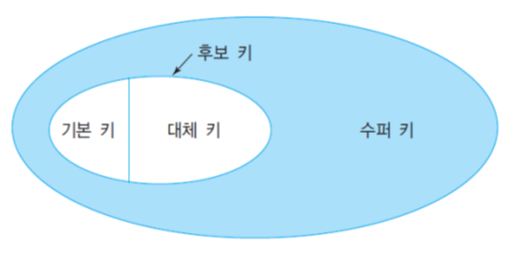
3. Keys
Alternate key
  Candidate key other than primary key (leftover candidate key)
  Example
    {PhoneNumber} is the alternate key

Slide 23
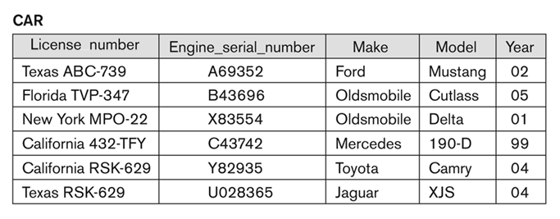
3. Keys
Quiz
  What are the candidate keys for the following CAR relation?
  Which attribute should be the primary key for the CAR relation?

Slide 24
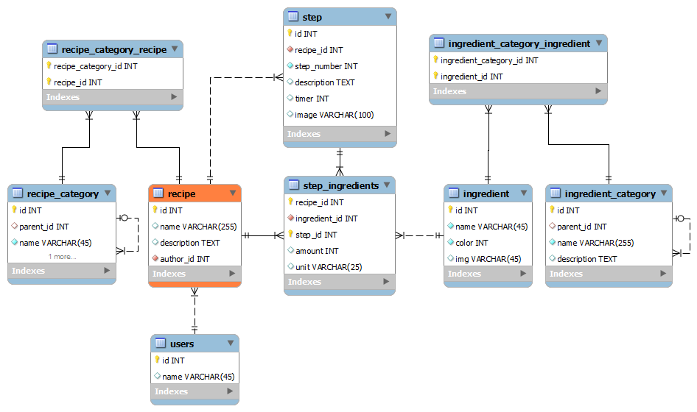
3. Keys
Foreign key
  Used to represent the relationship between relations in the database

Slide 25
3. Keys
Foreign key
  An attribute that creates a relationship between two relations
  Types of foreign key
    Foreign key referencing the primary key of another relation
    Foreign key referencing the primary key of its own relation
    Foreign key that is a composite of the primary keys

Slide 26
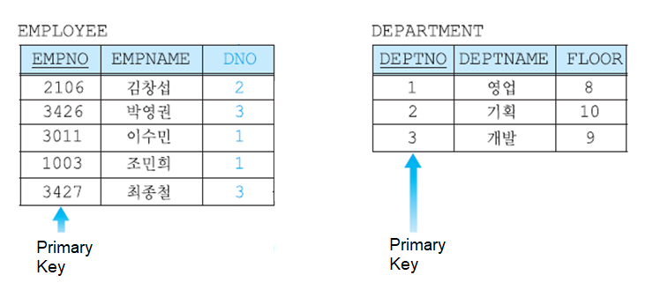
3. Keys
Types of foreign key
  Foreign key referencing the primary key of another relation

Slide 27
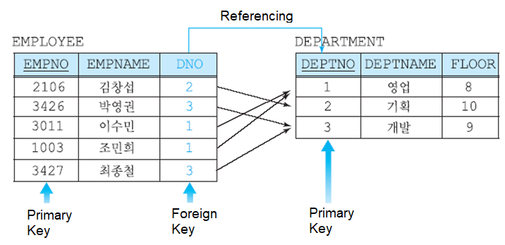
3. Keys
Types of foreign key
  Foreign key referencing the primary key of another relation

Slide 28
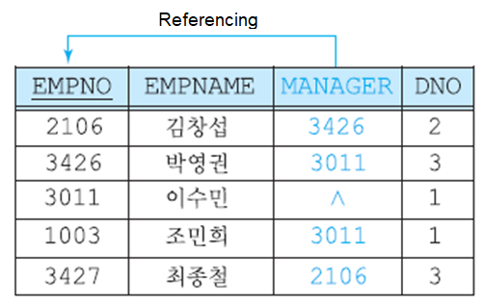
3. Keys
Types of foreign key
  Foreign key referencing the primary key of its own relation

Slide 29
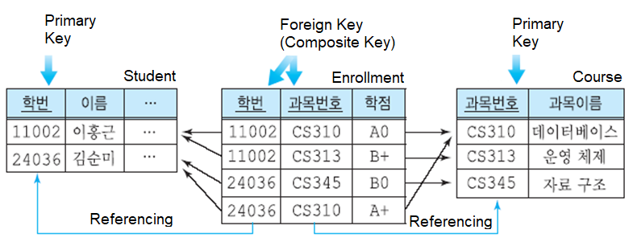
3. Keys
Types of foreign key
  Foreign key that is a composite of the primary keys

Slide 30
4. Integrity Constraints
Integrity constraints
  A set of rules used to ensure the accuracy and consistency of the relational database
  Types of integrity constraints
    Key constraint
    Domain constraint
    Referential integrity constraint

Slide 31
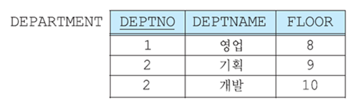
4. Integrity Constraints
Key constraint
  A set of constraints related to the primary key
  Constraint 1
    Every relation must have a primary key
  Constraint 2
    The attribute chosen to be the primary key must be unique
Not allowed. Because primary key must be unique

Slide 32
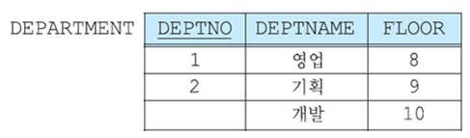
4. Integrity Constraints
Key constraint
  Constraint 3
    The attribute chosen to be the primary key must NOT be NULL
    Why a primary key cannot contain a NULL value?
      The primary key value is used to identify individual tuples in relation and if the primary key has a null value, then we can't identify those tuples.
Not allowed as primary key CANNOT contain a NULL value

Slide 33
4. Integrity Constraints
Domain integrity constraint
  Defines a valid set of values for an attribute
  Constraint 1
    Domain (data type) of each attribute in a relation must be declared
  Constraint 2
    Each tuple must have exactly one atomic value for an attribute
Not allowed because these tuples have multiple values

Slide 34
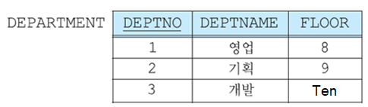
4. Integrity Constraints
Domain integrity constraint
  Constraint 3
    All values within an attribute must be in the same domain
      Must be the same data type
Not allowed because FLOOR is an integer attribute

Slide 35
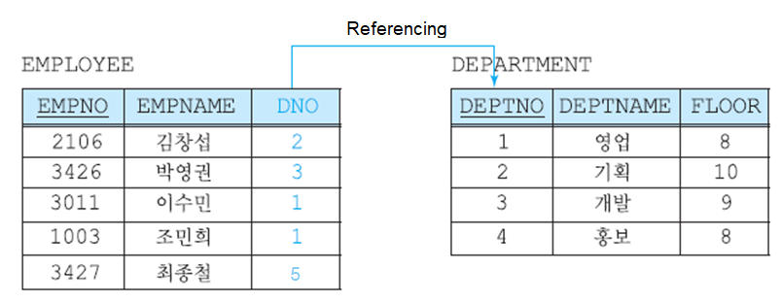
4. Integrity Constraints
Referential integrity constraint
  A set of constraints related to the foreign key
  Constraint 1
    If a foreign key in Relation A refers to the primary key of Relation B, then every value of the foreign key in Relation A must be available in Relation B.
Not allowed because there is no department 5

Slide 36
5. Pros and Cons of Relational Model
Pros of Relation Model
  Simplicity of model
  Ease of use
  Accuracy
  Data Integrity
  Normalization
  Security

Slide 37
5. Pros and Cons of Relational Model
Cons of Relational Model
  Not very good for large databases
  Difficult to find the relationship between tables
  Because of the complex structure
    Response time for queries is high
    Lack of scalability

Slide 38
6. Summary and Discussions
Relational Model
  Relational model represents the database as a collection of relations
    Relation = table
  Basic Terminologies
    Relation
    Tuple
    Attribute
    Degree
    Cardinality
    Domain
    Relation Schema
    Relation Instance
    Relational Database Schema
    NULL value

Slide 39
6. Summary and Discussions
Characteristics of relational model
Keys
  Super key, Candidate key, Primary key, Alternate key, Foreign key
Integrity constraints
  A set of rules used to ensure the accuracy and consistency of the relational database
  Types of integrity constraints
    Key constraint
    Domain constraint
    Referential integrity constraint

